Slide 1


Users’ Guide to the
Sources & Uses Template for Start-ups
June 24, 2025

Slide 2
Acknowledgements
This guide is a joint project of Food Co-op Initiative and Columinate. Thanks to everyone who has helped develop this guide and the Sources & Uses Template.
Bill Gessner – For his passion for co-ops and for mentoring so many cooperators over the years, as well as for originating the financial feasibility work for start-ups and creating the original Sources & Uses template.
Don Moffitt (Columinate) – For creating this new version of the Sources & Uses template and for help revise this guide.
Sarah Lebherz (Columinate) – for continuing Bill and Don’s work supporting start-up co-ops with financial feasibility guidance.
Jeanie Wells (Columinate) – For getting the project rolling.
Stuart Reid – For creating the original guide to the use of the Sources & Uses template.

Slide 3
Introduction – The Sources & Uses Budget
A Sources and Uses budget (S&U) is one of the most important business planning tools that a startup co-op will use. The primary purpose of the S&U is to ensure that co-op organizers know:
how much money will be needed to open your storefront, as well as the working capital needed after it opens - your Uses
where that funding will come from - your Sources
If your funding from all sources combined equals (or exceeds) the total of all Uses, you should be able to get a food co-op open. However, having enough money to open a co-op will not ensure its long-term success. Additional business and financial planning is essential to determine feasibility.

Slide 4
Introduction - The Sources & Uses Template
This is your guide to using the Sources & Uses Template for Start-ups. It’s an MS Excel workbook located on the FCI website.
The template has two key purposes.
The first purpose is to help start-up co-op steering committees understand how much cash is likely to be required to open their co-op.
Once you’ve entered your assumptions at the top of that worksheet (“Assumptions”) you’ll see a rough estimate of what it will take, financially, to open the co-op.
Then you can start building your funding plan – where you’ll raise the money needed – lower on that same worksheet.
That information—sources and uses of funds—is a key component of what you’ll need to provide to the person who develops your proforma.

Slide 5
Introduction - The Sources & Uses Template
The second purpose of the template is to help you understand the sources and uses of funds over time, in each stage of development.
The template takes the total uses and sources spreads them out over the five stages of development, showing when expenditures are likely to occur and which sources of funds you might consider for use during each stage.
Creating and maintaining a timely account of all sources and uses in the project is essential to good oversight and accountability. The organizing group can use this information to help build unity and understanding of the project with the co-op’s owners. For example, by explaining when owner equity money will be spent or why ownership and capital goals must be met before the co-op can move forward.

Slide 6
Introduction - The Sources & Uses Template
Pro Tip: Create multiple copies of the template with different project sizes, owned or leased, to compare what different scenarios will cost.
This tool is intended as a planning and strategic tool for boards to use without assistance, until you can afford expert technical help.
When you first start working with the Sources & Uses Template, it may seem complex and hard to understand. But it’s worth the time it takes to get familiar with it—think of it as a road map to one of the challenging aspects of opening a co-op.
When you have enough funding , we recommend that you work with a technical assistance provider to review your sources & uses budget and develop a proforma with ten years of projected financial results after the co-op opens. This will help ensure that the assumptions will lead to realistic financial projections.

Slide 7
Introduction - Assumptions
Some of the key assumptions will be highly variable and the information you enter into the template will change as you gather new information.
The cost of turning a site into a grocery store will depend greatly on the condition of what’s already there.
Typically, you’ll find a site that’s a good location but which needs a lot of work to turn it into your co-op. The assumptions in this template are based on that experience. For example, if you want to own a site, you may have to build the building, then build out the interior with lots of plumbing and electrical work, and you’ll have to grade, pave and landscape the site.
You may be surprised at how much it costs to build a grocery store, even a small one!

Slide 8
Introduction - Cash Flow
Having enough money to meet all of your project expenses is essential. It’s also critical that the money be there when you need it.
The S&U template has a worksheet on the tab “S&U Cash Flow” where you monitor the timing of funding (in-flows) and expenses (out-flows) to ensure that you plan your funding so that you have sufficient cash as it is needed.
The stages used for the template are those in the Food Co-op Development Framework. You can learn more about the Framework here: https://fci.coop/framework/.

Slide 9
Important Information for Users
Since the template is updated regularly, the numbers you see on the examples in this guide may not be the same as the default values that appear on the most current template.
The Sources & Uses Template is intended for use by co-op organizers. The use of this tool and/or the benchmark recommendations within it, does not in any way ensure that your actual budget and outcomes will be the same as those projected. Users should consult with professional advisors whenever possible.
None of the authors or sponsors of this guide are responsible for the accuracy or outcomes resulting from use of the guide or template.

Slide 10
Orientation to the Template
There are six worksheets in the template. The first and last are for general information (and don’t change). All of the magic happens in the other four. They are dynamic—they change as you enter information.
The only worksheet where you enter your information is “Assumptions”.
The next two, “Uses” and “Sources”, are all about the total amount of cash that your project is estimated to cost (Uses) and therefore how much you need to raise (Sources).
The fourth worksheet that changes is “S&U Cash Flow”. The key purpose of this worksheet is to help you understand what you’ll need to spend money on (and how much you’ll spend) in each stage of development—and therefore how much you’ll need to raise in those stages (and which sources will likely be available at the right time).

Slide 11

Orientation to the Template
If you haven’t done so already, go ahead and open the template. It’s located here.
At the bottom of the Excel workbook there are six worksheet tabs:

Slide 12
Orientation to the Template
Here’s a brief description of each worksheet:
Guide: a version of this visual guide to how to use the tool.
Assumptions: The ONLY worksheet where you enter your information. This is where you will fill in the information you have about your project.
Uses: Based on the assumptions, this tab breaks out the specific costs of starting your co-op. Do not change anything on this worksheet.
Sources: Based the assumptions, this tab gives a concise outline of your funding plan. Do not change anything on this worksheet.
S&U Cash Flow: Here you will find assumptions about how much cash you will spend in each stage of development for each cost as well as an initial plan for which source(s) of cash you’ll use at each stage of development.
Updates: this tab tracks the history of changes to the template (not your project).

Slide 13
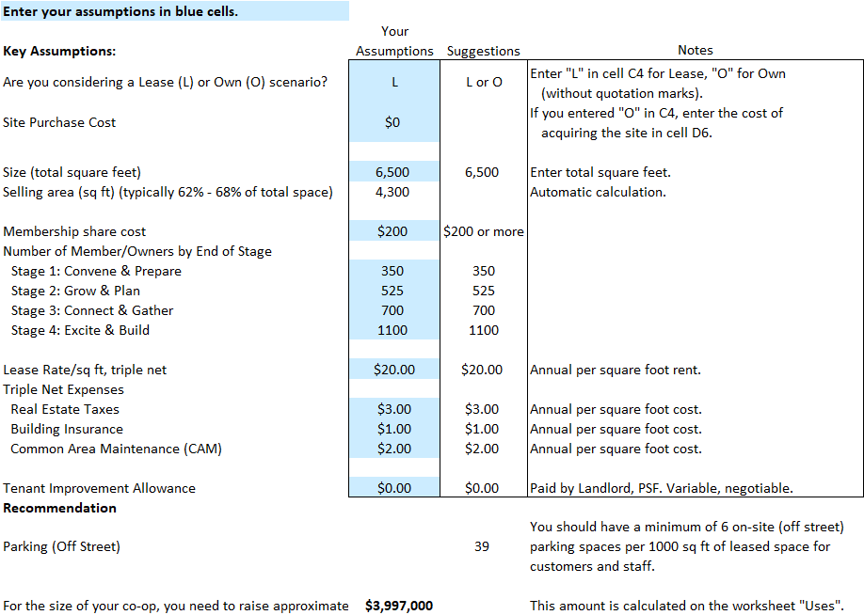
Worksheet: Assumptions
1
2
3
Remember: This is the only worksheet where you should make changes.
Here’s a quick orientation to the worksheet:
Only make changes to BLUE CELLS. Other cells contain formulas and should not be changed.
The “Suggestions” column contains benchmarks or examples based on co-op developer experience.
The Notes column provides a bit more information about the specific value.
The next four slides show where to enter assumptions.

Slide 14
Worksheet: Assumptions
Do you plan to lease a location? Or own it? Enter L for leasing, O for owning. Experiment with different scenarios. Typically, owning the site costs a lot more than leasing initially. But if a site is donated and the costs of the building, parking lot, landscaping, etc. are covered by grant funding, it could be better in the long run if it’s a good retail site.
If you entered O for owning, here’s where you enter the cost of obtaining the site.
There are a lot of variables in costs depending on factors like whether a usable building is already built.
1
2

Slide 15
Worksheet: Assumptions
How big will your store be? Use an estimate based on your vision of the co-op. As your plans change and mature, update as needed.
Enter your full owner equity requirement here.
Enter your goal for total owners paid in by the end of each stage – the Stage 4 number being paid in by the time the store opens. For a bit more information about how to determine these numbers check out the FCI video: Setting Ownership Goals
1
2
3

Slide 16
Worksheet: Assumptions
Most new co-ops end up in a leased site. Enter market commercial rent for your area here.
Whether you lease or own, the co-op will have these annual costs.
The tenant improvement allowance is sometimes extended by the landlord. Rent is usually higher with a TIA. The result of your entry here will show below on funding plan.
Parking is incredibly important for most food co-ops. This field figures adequate parking needed so you can include that in your site search.
1
2
3
4

Slide 17
Worksheet: Assumptions
The total cost will probably surprise you but be assured that it is typical. In the “USES” section we unpack what expenses are contained in that number.
It’s important to begin to acclimate to the fact that projects like this cost real money, and that that investment is intentional to ensure the long-term success of your project.
1

Slide 18
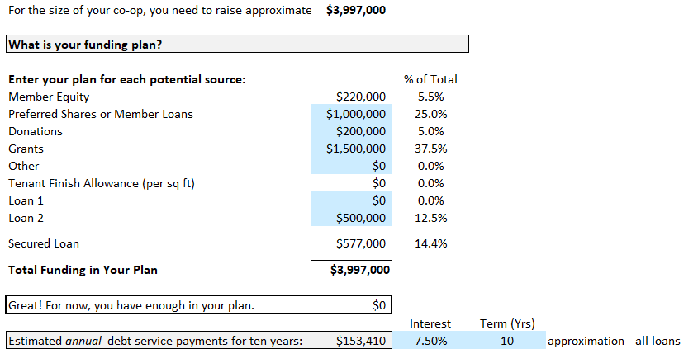
Worksheet: Assumptions
Funding Plan
Now let’s start to enter where we think we will get the money to complete the project. This section has three main groups of funding:
Member/Owner Investment - equity, member loans, or special equity
Community Investment - donations, grants, or other money from community institutions not requiring interest or repayment.
Debt
1
2
3

Slide 19
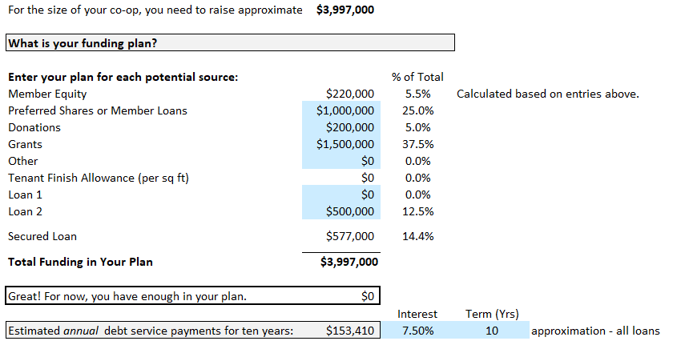
Worksheet: Assumptions
Funding Plan - Member Investment
As owners of our cooperative business, the members can provide patient capital to support building the business:
Member Equity - this is the member/owner share: Whatever share dollar amount you put in above multiplied by the total number of members you plan to have by the time you open.
Preferred Shares or Member Loans - these are ways for members to invest larger sums in the co-op, beyond the equity to become a member.
1
2

Slide 20
Worksheet: Assumptions
Funding Plan - Community Investment
From the local community to the larger co-op community, and from grassroots donations to larger grants, there are often opportunities to build the case for support of your project.
Donations - from donations when tabling to large individual donors to fundraising events.
Grants - community foundations, HFFI and other national grant programs, etc.
Other - ask questions in your community and your networks about other opportunities.
1
2
3

Slide 21
Worksheet: Assumptions
Funding Plan - Debt
The most costly of potential sources, debt can be necessary to build the store your community is envisioning.
Loan 1, Loan 2 - Space for two different subordinated loan amounts, for example LEAF and Shared Capital.
Secured Loan - First position debt is automatically figured to be no more than 15% of your total project cost.
Enter the current average commercial interest rate and assumed term.
1
2
3

Slide 22
Worksheet: Assumptions
Funding Plan - Bottom Lines
With your current assumptions about funding and financing added, you can now see:
Total Funding in Your Plan - the total of the member, community, landlord, and lender investments
This line indicates whether you need to find more funding or if your plan is sufficient.
Annual debt service - the number of absolute dollars you’ll be paying out of your operational budget to service debt per year.
Your goal is to keep debt LOW, and reduce your gap to $0.
1
2
3

Slide 23
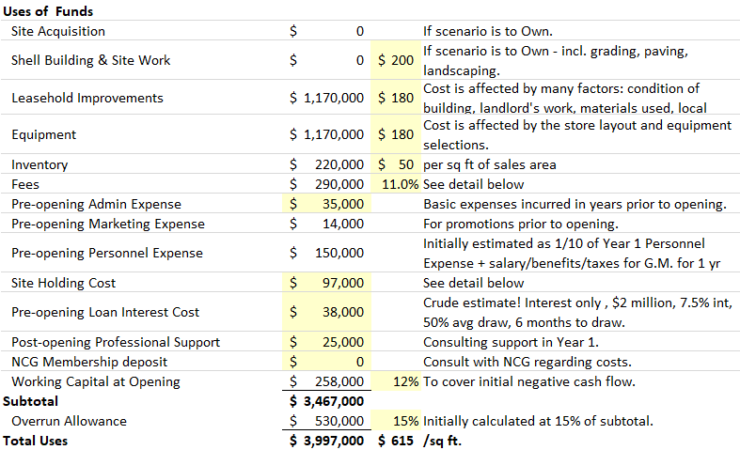
Worksheet: Uses
Every site needs updates and renovations. Utilities, heating and air conditioning almost always need significant investment. Do not assume you can beat the average unless you have concrete cost estimates!
Equipment includes refrigeration, shelving, office equipment and more. The benchmarks are based on buying new equipment. Refurbished may be available, but is likely to cost more over time due to lower efficiency and more repairs.
Note: Both of these apply to the total square footage of your store. The costs are calculated automatically from your entries on the worksheet Assumptions.
1
2

Slide 24
Worksheet: Uses
Inventory costs are based on the size of the selling area of the co-op.
Fees encompasses a wide range of costs that you will incur for consultants, professional services, etc. A detailed breakdown is generated below so you can fine tune these when you have actual bids.
Pre-opening Admin covers all the incidental “office expenses” along the way.
1
2
3
NCG Membership Deposit

Slide 25
Worksheet: Uses
Pre-opening Marketing is critical to ensure your co-op gets the attention it needs to bring people in when you open. Don’t skimp!
You will need to hire and pay a General Manager and the rest of the staff before the store is open.
Once you commit to a site, you may have to pay a deposit, rent or other related costs. There is a detailed breakdown of these costs below.
1
2
3

Slide 26
Worksheet: Uses
In order to pay for site improvements and equipment, you will probably be drawing on your loans well before opening. In many cases interest payments will be due.
New food co-ops typically run into problems after they open and it is recommended that you set aside funds to pay for professional support during the first year after you open.
Co-ops planning to open as National Co+op Grocers members need to budget for fees and the “Joint Liability Fund”.
1
2
3

Slide 27
Worksheet: Uses
All new businesses lose money for a while after opening, and would run out of cash if they did not have reserves set aside before opening - do not skimp on working capital.
The overrun allowance is your protection against unforeseen expenses, which are common.
This is what you see on the worksheet “Assumptions” for total costs of opening the co-op.
1
2
3

Slide 28
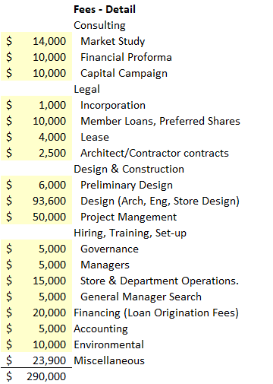
Worksheet: Uses
Fees Detail
This section (rows 24-47) of the worksheet “Uses” breaks out the total fees to show you what’s included. It also allows for timing by stage on the worksheet “S&U Cash Flow”.
Miscellaneous (at the bottom) calculates automatically.

Slide 29
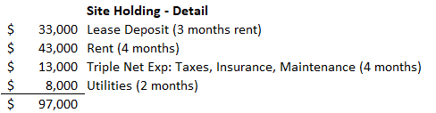
Worksheet: Uses
Site Holding Detail
This section (rows 49-54) of the worksheet “Uses” breaks out the total amount of site holding costs to show you what’s included. It also allows for timing by stage on the worksheet “S&U Cash Flow”.
All these items are figured based on entries on the worksheet “Assumptions”.

Slide 30
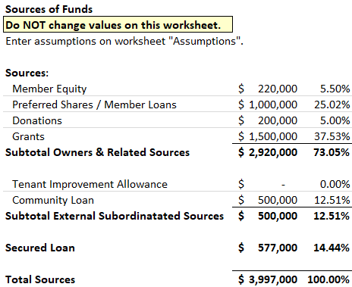
Worksheet: Sources
The worksheet “Sources” restates your funding plan and allows for timing of funding by stage on the worksheet “S&U Cash Flow”.

Slide 31
Sources & Uses Cash Flow by Stage

Slide 32
The purpose of Cash Flow by Stage
As you move along the development timeline, bills will keep coming in. Funding should also keep coming in. Like any other stage of business, it is important that the money is there before the bills come due.
Most of your capital will be raised in the final stages of the co-op’s development, when the major expenses occur. In the early stages, a grant or new owner equity may cover all or most of your organizing costs.
If you hire a project manager, will you be able to continue their salary if ownership growth slows or the main capital campaign is delayed? The cash flow budget can help you analyze your options and plan ahead.

Slide 33
Worksheet: S&U Cash Flow
The fifth worksheet of the Sources & Uses template is on the tab “S&U Cash Flow”. It breaks down expense (Uses) and funding (Sources) throughout the organizing process by the stage in which it’s expected to happen.
Initially, all of the entries flow from the worksheets “Uses” and “Sources” and are made automatically based on your entries on “Assumptions”.

Slide 34
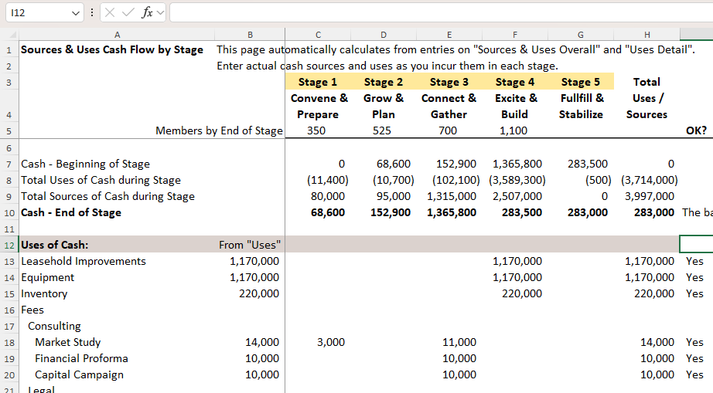
Worksheet: S&U Cash Flow
The first two columns are a detailed description of:
the total Uses of Cash (the amount your project is estimated to cost to open) in rows 12 to 52
the total Sources of Cash (the amount you’ll need to raise) in rows 54 to 62.

Slide 35
Worksheet: S&U Cash Flow
The next five columns (C to G) divide the total amount of cash into each stage.
Column H totals up the five stages. Column I compares that total to column B to make sure there’s no error.

Slide 36
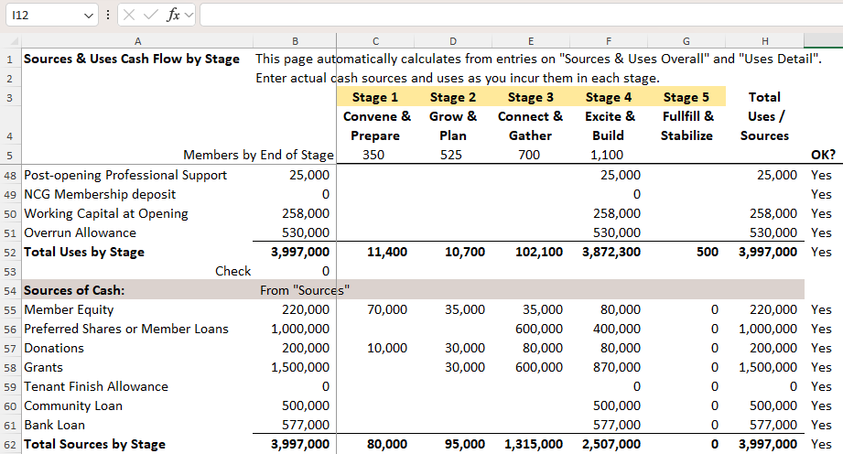
Worksheet: S&U Cash Flow
The total Uses of Cash are on row 52. Column B is the total estimate for opening the co-op. Columns C to G show the estimated amount you’ll spend in each stage of development.

Slide 37
Worksheet: S&U Cash Flow
The total Sources of Cash are on row 62. Again, column B is the total estimate for opening the co-op. Columns C to G show the estimated amount you should plan to raise in each stage of development.

Slide 38
Worksheet: S&U Cash Flow
Near the top of the worksheet, in rows 7 to 10, there’s a summary for each stage. There’s zero cash at the beginning of Stage 1, with the estimated Uses and Sources of cash (spent and raised), and a calculation of the cash remaining at the end of the stage.

Slide 39
Worksheet: S&U Cash Flow
If the estimated cash at the end of any stage (row 10) is negative, the co-op will be in trouble. The team will have to figure out how to spend less or raise more in order to keep moving forward.

Slide 40
Worksheet: S&U Cash Flow
This is your tool. If you want to change the stage in which an expense will occur, you can overwrite the formulas in columns C to G. Be sure of two things:
cash at the end of each stage (row 10) is positive, and
column H equals column B (if it does, the word “Yes” should appear in column I).

Slide 41
In Conclusion
We suggest preserving a copy of the template with your original assumptions entered, before modifying it in any way. That will give you a baseline to which you can refer back to at any time.
A final warning: you may be tempted to change the assumptions provided in the template (for example, for the cost of equipment per square foot of store) to make the project look easier to complete. The assumptions provided are based on the experience of many, many co-ops. If you reduce them significantly, you substantially increase the risk that you will not raise enough money to successfully open and operate the co-op. Don’t do it unless you are very well informed.

Slide 42
One of many tools…
Besides financial feasibility you will need to examine the feasibility of the market and a particular location. You’ll need a professional market study tailored for your vision and a review of the location by a team well-versed in the needs of co-ops.
The Sources & Uses budget is only one of many important pieces of your financial planning. You’ll also need a set of professionally created financial projections (proforma) to establish the financial sustainability of your co-op.
For more information on all the development work that shows up in the Sources & Uses Budget, contact Food Co-op Initiative at info@fci.coop, or visit our web site at www.fci.coop.
Columinate provides specialized consulting services to start-up food co-ops in many areas, including working with budgets, capital campaigns, market studies, and board training. You can reach them at info@columinate.coop, or through their web site www.columinate.coop.

